Slide 1
Shell Bootcamp 2024 3 Reflections for Week #<>
Riya Gandhi
Date : 30-Aug-2024

Slide 2

About Me
‘Embrace the effort, let go of the outcome.’ This motto describes me the most. I intend to focus mostly on the work. I have been focusing on having a growth mindset rather than a fixed one and trying to step out of my comfort zone. I wish to keep learning things no matter how much time it would take to change myself. One thing I learnt and understood from the sessions is that it is okay to be wrong and be laughed upon, take it positively and just move on with the learnings.

Slide 3

My learnings from this week!

Slide 4
Learning 1 | My takeaways
Networking and Behavioral Etiquette: Understanding how to create and maintain professional relationships is crucial. This includes knowing how to behave in a corporate environment and recognizing different types of team members.
Growth vs. Fixed Mindset: The role play on growth and fixed mindsets, along with neuroplasticity, highlights the importance of being open to learning and adapting.
Self-Awareness and Managing Complexities: Being aware of your strengths and weaknesses and learning how to navigate complex situations at work.
Professional Grooming and Business Etiquettes: The importance of presenting yourself well and adhering to business etiquettes, including active listening and effective email writing.
Apart from these topics, active listening, grooming and email writing topic were also covered.

Slide 5
Learning 2 | My takeaways
On Day 2, we delved into stakeholder management, which initially seemed dry but was made engaging through activities like role plays and creating a company idea with a logo and tagline. The theory sessions covered stakeholder management, stakeholder plan management, stakeholder engagement, and stakeholder mapping. We learned about internal and external stakeholders, the power-interest grid, and the Shell Trust Model, all demonstrated through interactive role plays and case studies. The key learning was understanding the importance of effectively managing and engaging stakeholders. The main takeaway is that successful stakeholder management requires a strategic approach to ensure all relevant parties are considered and engaged appropriately. This involves using tools like stakeholder mapping and the power-interest grid to prioritize efforts and build strong, trust-based relationships. In the Energy sector, effective stakeholder management is crucial for driving innovation and efficiency. By building strong networks and engaging stakeholders through structured plans and transparent communication, companies like Shell can navigate complex projects and regulatory environments more effectively.

Slide 6
Learning 3 | My takeaways
During the team-building exercise, we played a game where a pen was tied with four strings, and we had to write a word by pulling the strings together. This activity highlighted the importance of teamwork and coordination, aligning with Tuckman’s stages of team development: forming, storming, norming, and performing. We also learned about the growth mindset, emphasizing the value of giving and receiving feedback and constructive criticism. Additionally, we were taught presentation skills, focusing on body language, gestures, confidence, and voice modulation, which we practiced by presenting on a topic of our choice. In the Energy sector, these concepts can be implemented to enhance project management and innovation. Effective presentation skills are essential for conveying technical information clearly to stakeholders and advocating for sustainable energy practices.

Slide 7
Learning 4 | My takeaways
Day 4 was a technical session on BA (Business analyst) and Agile methodology. The session started with the instructor explaining the work of BA by giving real life examples, followed by him explaining the roles BA plays in a company.
We also learned how the requirement analysis is done by BA and how he documents the requirements using charts or tables or normal points.
SMART criteria was explained which is stated as specific, measurable, attainable, relevant and time-based work.
Requirement management was also taught in the class and also explained RTM (requirement traceability matrix).
The topic of SPM which is a proper way of planning and leading projects was explained with real life examples.
What documents are created by BA were also covered like BRD and SRS documents. A BA is a link between the client and the developers.
Shell benefits from these trainings by making their employees aware of how they are expected to work and perform and what terminologies would be used when they work

Slide 8
Learning 5 | My takeaways
Day 4 started with a group activity where we were given scenarios and asked to create BRD and SRS document. It was a fun activity, and the instructor even corrected us.
Then we started the topic of SDLC models in which initial phases are - initial, analysis, design, coding, testing, delivery and maintenance. We covered waterfall model, V model, Prototype model and came to Agile model.
In agile model we started exploring scrum framework. In which we discussed sprints whose duration can be of 2/3/4 weeks depending on the task assigned.
Each topic is considered as a user story. Scrum team includes a scrum master and the other members, the team size cannot exceed 9 members, and a scrum master can head more than one teams. Scrum artefacts included product backlogs, sprint backlog and burndown chart. Scrum ceremonies included kick off meeting (occurs at the starting and only once) after this meeting sprint 1 starts.
Then there is sprint planning meetings - occurs on Tuesdays, is the first meeting of any sprint and duration is of 2-3 hours.
Then we have daily scrum stand up meeting which is for 15 mins, and it covers the points like what was done yesterday, what will be covered today and are there any challenges faced.
Third meeting is sprint grooming/refinement meeting - occurs in the mid of a sprint and duration is of 2-3 hours.
Then there is sprint demonstration meeting which occurs on the last day of the sprint and duration is of 1 hour. Last is sprint retrospective meeting for 1 hours which discusses what went well, what could have been done better etc.

Slide 9

Relevance of learnings for my organization

Slide 10
Learning 1 | Relevance for Shell
Shell implements these learnings by fostering a culture of continuous improvement and collaboration. They emphasize the importance of networking through partnerships and alliances within the workplace. Shell encourages a growth mindset by investing in employee development programs and embracing new technologies and sustainable practices. They promote self-awareness and managing complexities through comprehensive training and support systems, ensuring employees are well-equipped to handle the dynamic challenges of the energy sector.
By implementing these learnings, Shell benefits through enhanced innovation and efficiency, driven by strong networks and collaborative efforts. The growth mindset allows Shell to stay ahead in the rapidly evolving energy sector, adapting to new technologies and sustainable practices. Self-aware and well-trained employees can navigate complex projects and regulatory environments more effectively, leading to better project outcomes. Shell has SOPs (standard operating procedures) designed for each employee of the company and they operate in a very professional as well as respectful manner.

Slide 11
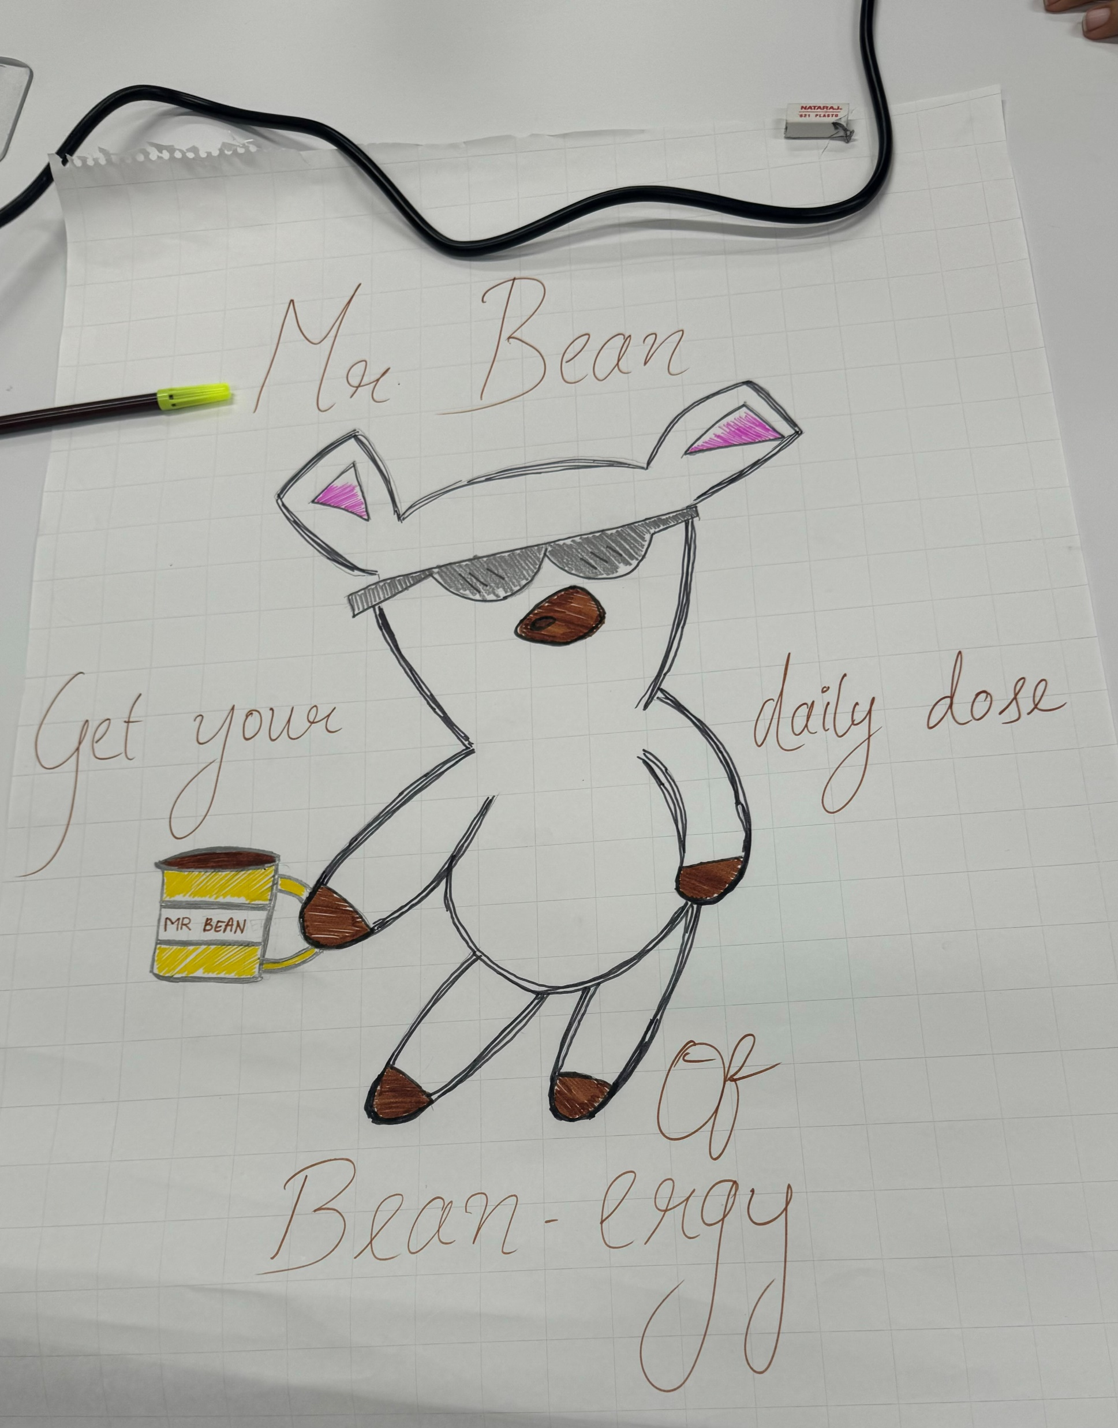
Learning 2 | Relevance for Shell
Shell implements the learning of effective stakeholder management by integrating it into their core business practices. They prioritize building strong relationships with both internal and external stakeholders through regular engagement and transparent communication. Shell uses structured plans and tools like stakeholder mapping and the power-interest grid to ensure that all relevant parties are considered, and their needs are addressed. Shell benefits from this learning by enhancing innovation and operational efficiency. Effective stakeholder management leads to stronger partnerships and collaborations, driving the development of new solutions and technologies. By maintaining transparent and consistent communication, Shell builds trust with stakeholders, which is crucial for navigating complex projects and regulatory environments

Slide 12
Learning 3 | Relevance for Shell
Shell implements the learning of teamwork and effective communication through practical activities and structured models. For instance, team-building exercises like the pen-and-string game help employees understand the importance of coordination and collaboration. By incorporating the Tuckman model, Shell guides teams through the stages of forming, storming, norming, and performing, ensuring that they develop cohesively. Additionally, Shell emphasizes a growth mindset by encouraging employees to give and receive constructive feedback, fostering an environment of continuous improvement. Presentation skills are also honed through practice, focusing on body language, gestures, confidence, and vocal pitch, which are essential for effective communication. By implementing these learnings, Shell benefits from enhanced teamwork and communication within the organization. The structured approach to team development ensures that teams are well-coordinated and capable of high performance. Encouraging a growth mindset and constructive feedback leads to a culture of continuous learning and adaptation, which is crucial in the dynamic energy sector. Improved presentation skills enable employees to communicate ideas more effectively, both internally and externally, enhancing Shell’s ability to engage with stakeholders and present innovative solutions.

Slide 13
Learning 4 | Relevance for Shell
For Shell, these trainings are highly relevant as they ensure employees understand their roles and the terminologies used in their work. As a contributor, I can apply this knowledge to enhance communication and collaboration within project teams. By effectively documenting requirements and using SMART criteria, I can help streamline project processes and ensure alignment with client expectations. Utilizing RTM and SPM techniques will aid in managing project requirements and timelines efficiently, ultimately contributing to the successful delivery of projects in the energy sector.

Slide 14
Learning 5 | Relevance for Shell
Shell can significantly enhance the efficiency of employees by Agile and Scrum processes. By automating repetitive tasks, such as setting up development environments, running tests, and deploying code. The basic knowledge of such technical subjects is necessary to all the employees, and it helps them understand their workspace better. With real life demonstrations learning becomes fun too. Shell benefits by training their employees prior to their joining, so that their employees when they join the team are ready to work with their best versions.

Slide 15

Challenges in implementing learning

Slide 16
Challenge faced while implementing Learning 1
One of the main challenges I faced was dealing with feedback and critical criticism. Initially, I might have felt overwhelming or discouraging. Additionally, being shy to speak up in group settings or during discussions made it difficult to fully engage and share your thoughts. But to overcome this, I am learning and practicing speaking up along with a growth mindset. I am also now open to seeking help from my peers as well.

Slide 17
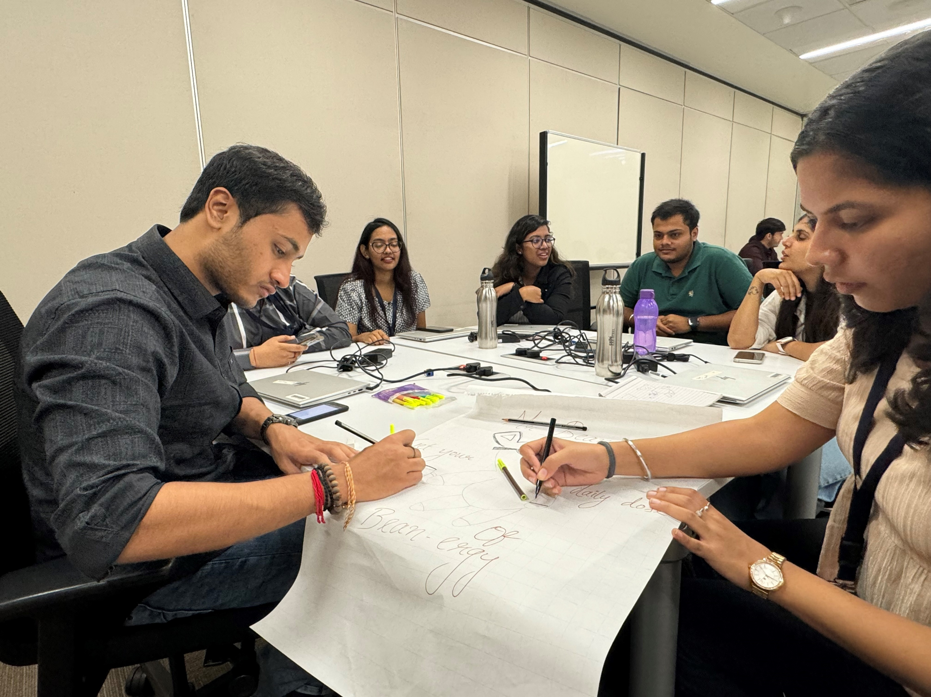
Challenge faced while implementing Learning 2
The challenges faced related to this topic could be balancing the diverse interests, it sometimes becomes difficult to handle the situations when people have rigid mindsets. Maintaining a transparent communication throughout with all the stakeholders can be tough as there can be events when someone is left to inform. Adapting to rapid changes in the energy sector as well is hard to cope with. I think with continuous learning and observations and trying to keep everyone in loop these issues can be resolved easily and it has to be done recursively.

Slide 18
Challenge faced while implementing Learning 3
One major challenge was managing stage fright and nervousness while presenting. To overcome these challenges, I plan to practice regularly in front of a mirror or record myself to observe and improve my body language and gestures. Joining a public speaking club or group can provide a supportive environment to practice and receive constructive feedback. To manage nervousness, I will use relaxation techniques such as deep breathing exercises before presentations.

Slide 19
Challenge faced while implementing Learning 4
During the technical session on Business Analysis (BA) and Agile methodology, several challenges emerged. One significant challenge was understanding and applying the various documentation methods, such as charts, tables, and bullet points, for requirement analysis. Additionally, managing and implementing the Requirement Traceability Matrix (RTM) and Software Project Management (SPM) concepts in real-life scenarios posed difficulties. To overcome these challenges, I plan to engage in continuous learning and practice. For documentation methods, I will review and practice creating different types of documents, such as Business Requirement Documents (BRD) and System Requirements Specifications (SRS).

Slide 20
Challenge faced while implementing Learning 5
There were initial challenges when we were asked to create the technical documents, but the instructor cleared the doubts properly and we could demonstrate it very well. There can however be issues when team members resist to each others opinion, but such situations can also be managed well with proper approach and way of talking and explaining things.

Slide 21

Action Plan

Slide 22
My Action Plan for this Week
Actions
Timeline
Status
Now first of all I will be confident and try to address issues with a growth mindset, coming to the technical training portion I am trying to absorb all the details and am looking forward to the upcoming sessions on different topics like DBMS, DevOps and lot more. Learning and networking is the key to success within shell
This week was mostly on developing confidence, and I focused on it.
After that the technical training started in that I am looking forward to activities for better understanding.
I plan to note down the main takeaways and learn more about them
I have already started implementing things taught in soft skills sessions and now I am focusing more on the technical training topics.

Slide 23

Learning is also Fun!

Slide 24
Learning is also Fun!
There were so many fun activities, but I personally enjoyed pen-and-string activity demonstrating teamwork.
I also remember the role plays we had as a board meeting discussion which went very well.
On Day 5 we were asked to create BRD and SRS documents, this activity was fun too as it taught me so much.
I tried paying attention to all the small details and cover as much as I could.

Slide 25

Summary
Quick summary – The starting of the week was mostly the sessions of soft skills, were I learned of growth mindset, being confident to put forward your point, become an active listener and work more and more on networking with people within the office.
Importance of topics of upcoming week – upcoming topics include software testing, DevOps, Cloud, DBMS and case work,
Connectivity of topics from current week – This week in technical we were taught BA and Agile so these topics would be carry forwarded along with the new ones.

Slide 26
Thank You

